Slide 1



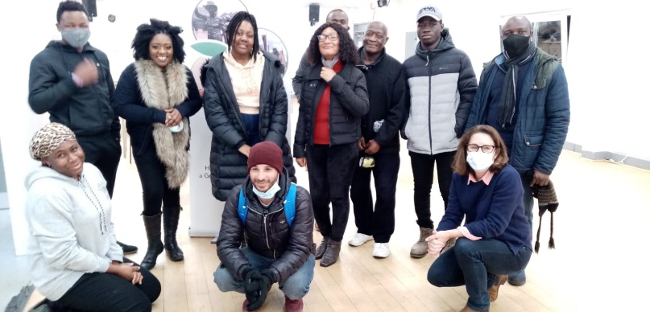
Co-producing research with asylum seeking community in Glasgow
Taulant Guma– Edinburgh Napier University
Yvonne Blake – Migrants Organising for Rights and Empowerment
Edinburgh, 7th January 2025

Slide 2
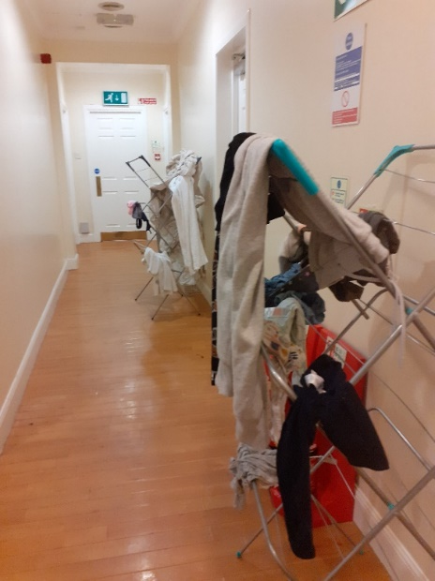
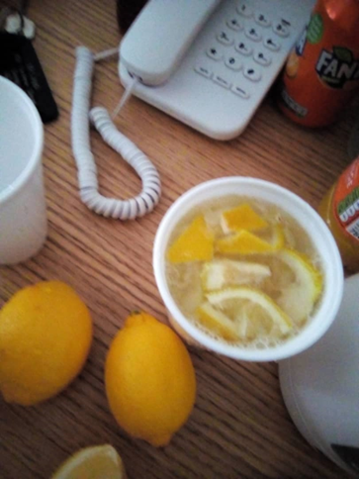
About the study
Safe environment? Investigating the use of temporary accommodation to house asylum seekers and refugees during the Covid-19 outbreak
Document housing conditions under Covid-19
Gather evidence from the perspective of asylum seekers
To influence government policies and change the system for the better
To raise public awareness about the issues

Slide 3
A digital ethnography
  Do research together with MORE, a migrant led grassroots group in Glasgow advocating for human rights and dignity for asylum seekers and refugees living in the UK
  Research ‘not on but with’ those individuals whose lives are being studied
  Working together throughout the research process, data collection, analysis, etc.

Slide 4
Trust
“As you are aware this kind of partnership requires mutual trust which requires the commitment of both parties. As a result, I would like to propose an initial phone meeting with you so I can get a better understanding of the focused study, followed by a zoom meeting with our group. This will provide an opportunity for you to provide some context regarding the research process, the focus study and crucially the impact of these studies in influencing government policy and or societal perception.”
Approaching MORE
  Open and clear about the aims of research and why choosing them
Getting MORE involved in the research
    2 community researchers
    Documentary
Co-design of study
  Use of laptops, not phones
  Interpreters – Arabic, French, Spanish

Slide 5
Care
Recruitment – pretty quickly
  8 men and 6 women of different ages, nationalities, etc - all had experiences of hotel-type accommodation
  MORE already having trusted relationships with individuals
Managing these existing relationships
  Became part of research as well as service
  Create dilemmas for few participants
  Feeling obliged to participate
  Care not to affect people’s access to support

Slide 6
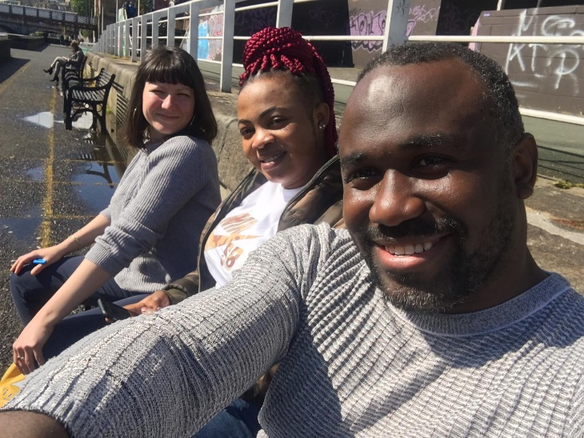
Co-learning
Practitioners-cum-researchers
  Weekly meetings conversations with participants - very difficult circumstances
  Doing interview online through interpreting
  Also carrying daily work - busy practitioners
How to ‘collect data’? What is research?
  Use WhatsApp? Skype? Zoom? – different ways of working/researching
  What to ask participants? New questions? What not to ask?
Ongoing conversations and co-learning

Slide 7

Visual diaries
Another layer in co-production
Participants having a say in the research process
  take photos, record your voice, or make short videos of daily life
Some didn’t feel like sending regularly
  Under challenging circumstances – not just Covid but Hostile Environment
A few didn’t want to be in the film
I’m Still Here (18 min) – 2022
https://www.youtube.com/watch?v=PBbZWzYMHsQ

Slide 8
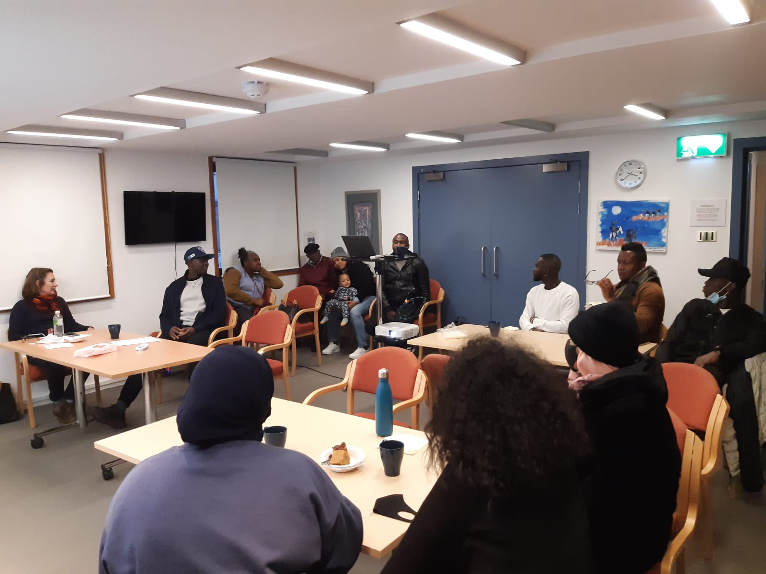
Feedback and sharing
Research as social event
  2 workshops at the start, 1 feedback event later about first cut of film
  Getting to know each other
  Being part of the project
  Sharing culturally and religiously appropriate food
Having their say on research/film:
  Include footage of ‘Mothers and Baby’ Unit.
  Too ‘positive’ some aspects, negative side needs more emphasis
  Pictures of hotels to be included as reminder of these negative experiences
One participant didn’t want to be included in the film

Slide 9
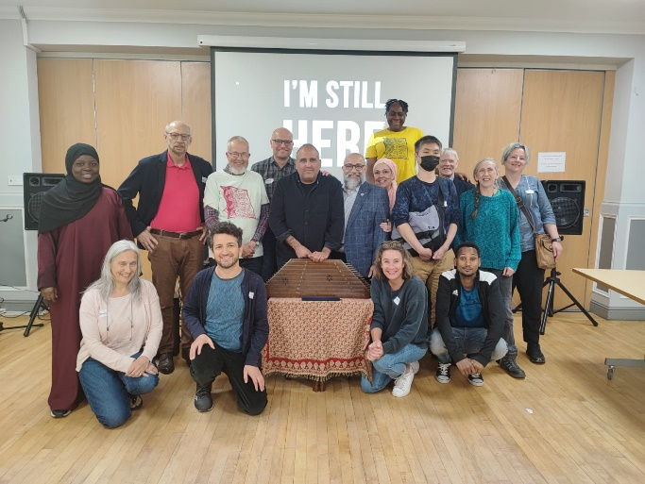
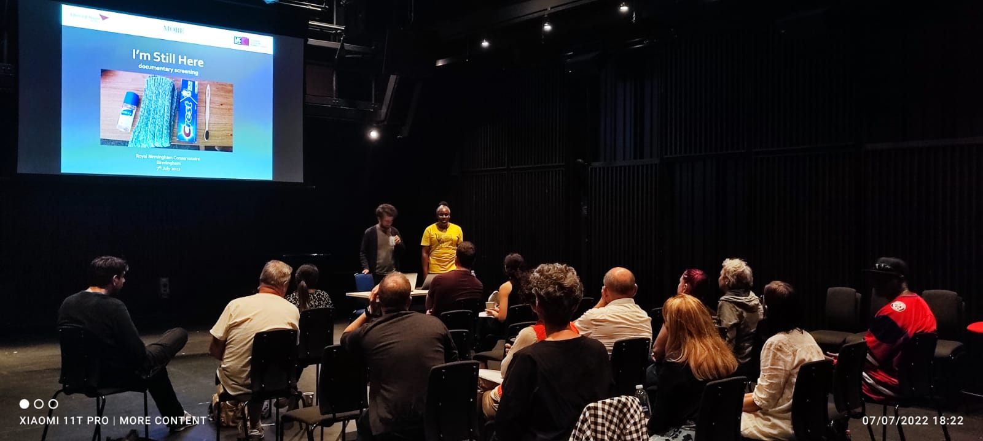
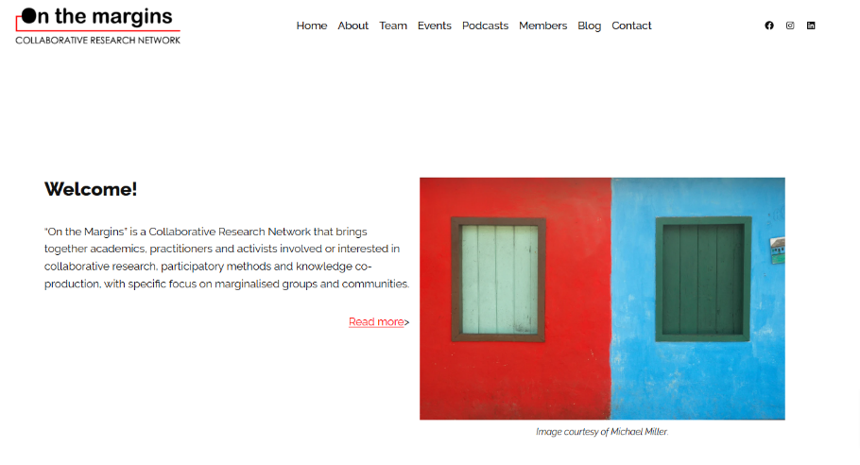
Ongoing relationships
Film screenings around the UK – Glasgow, Falkirk, Birmingham, Aberdeen
Raise awareness about issues faced by people seeking asylum
Maintaining ongoing relationships with MORE and community
On the Margins!

Slide 10
Co-production
Often seen as an ‘alternative’, ‘messy’ and ‘complex’ form of research
But ‘trust’, ‘care’, and ‘relationships’ not just about participatory or co-produced research
All kinds of research should be underpinned by these principles

Slide 11

https://tempacco.wordpress.com/ https://onthemargins.org.uk/

